Slide 1
SIZE OF THE TEST

Slide 2
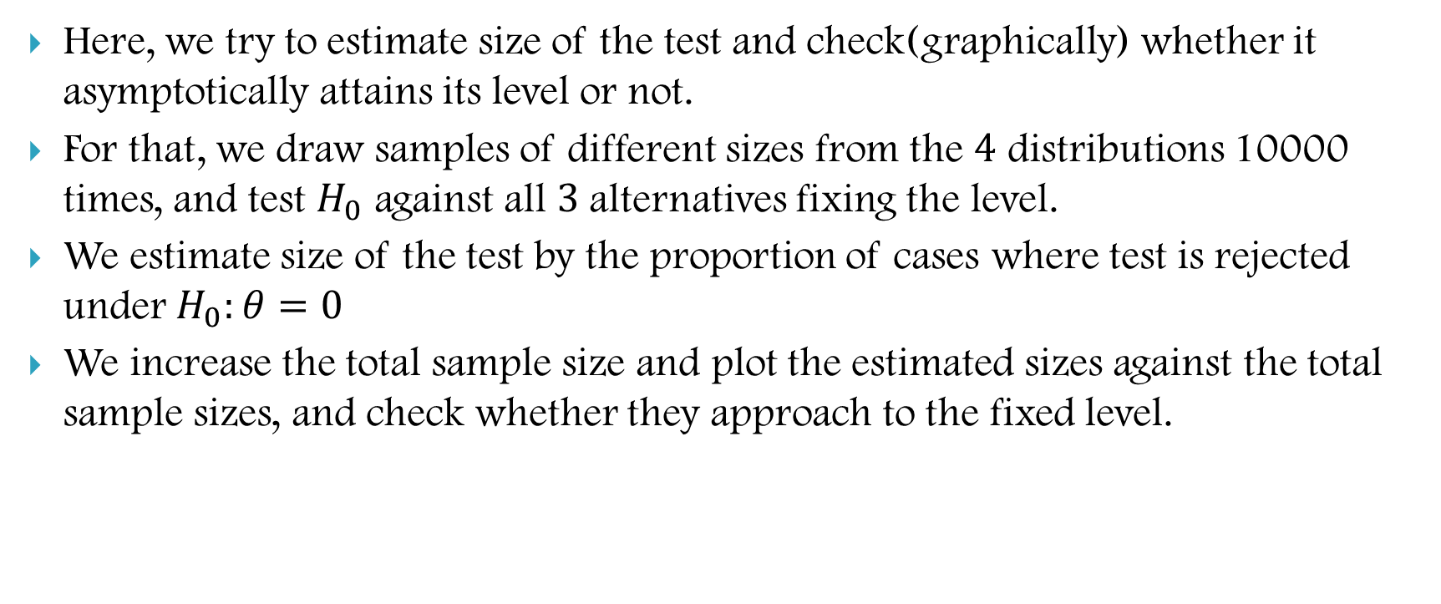
Size of the Non-Parametric Test
Here, we try to estimate size of the test and check(graphically) whether it asymptotically attains its level or not.
For that, we draw samples of different sizes from the $4$ distributions 10000 times, and test $H_{0}$ against all $3$alternatives fixing the level.
We estimate size of the test by the proportion of cases where test is rejected under $H_{0}:θ=0$
We increase the total sample size and plot the estimated sizes against the total sample sizes, and check whether they approach to the fixed level.

Slide 3
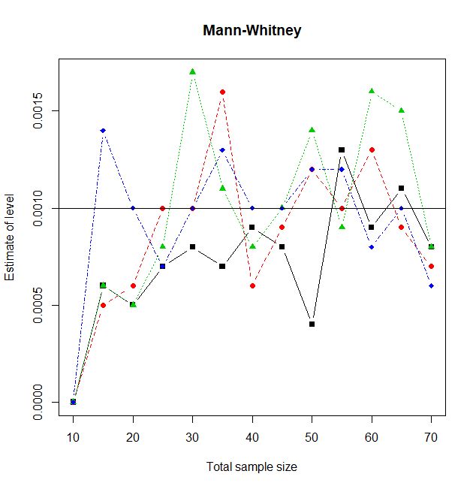
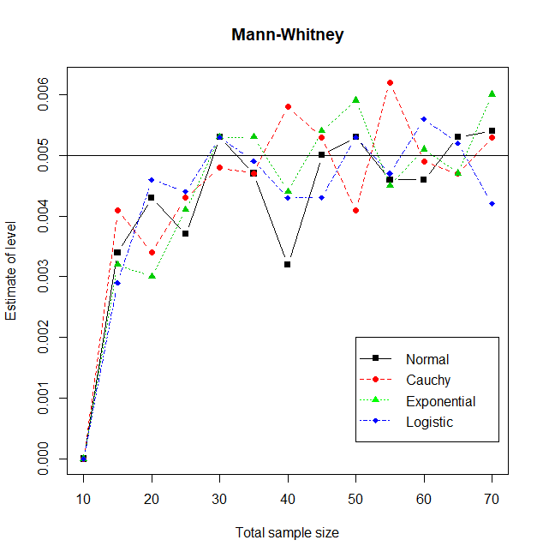


$$α=0.001$$
$$α=0.005$$

Slide 4
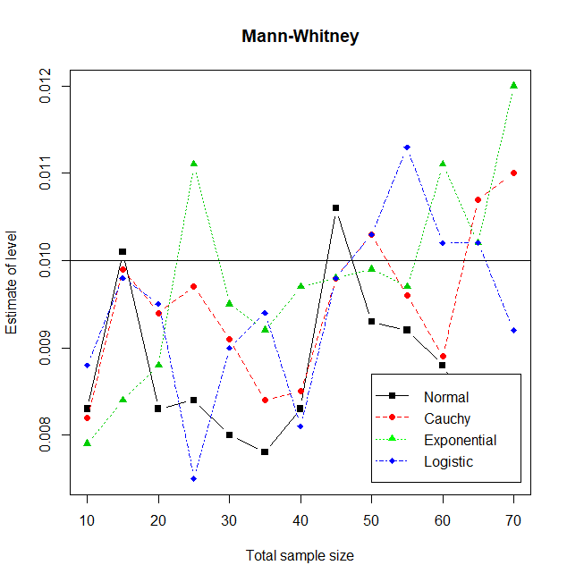
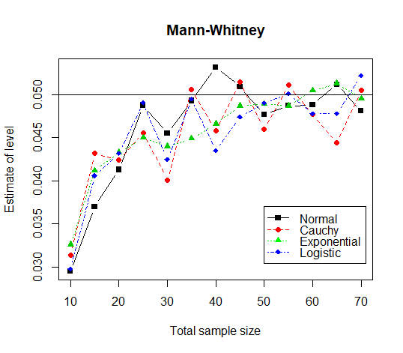


$$α=0.01$$
$$α=0.05$$

Slide 5
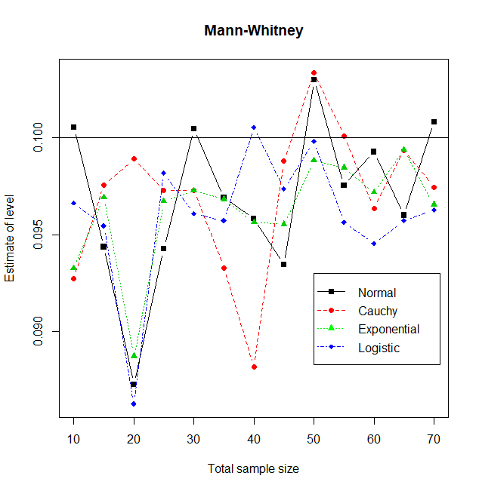
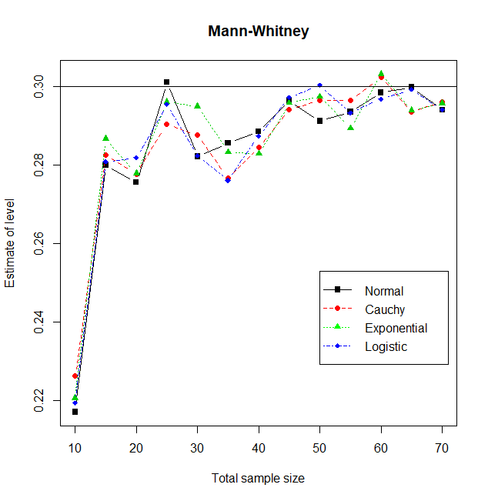


$$α=0.1$$
$$α=0.3$$
In all the cases, as the total sample size increases, the estimate of size of the test gets close to actual level .

Slide 6
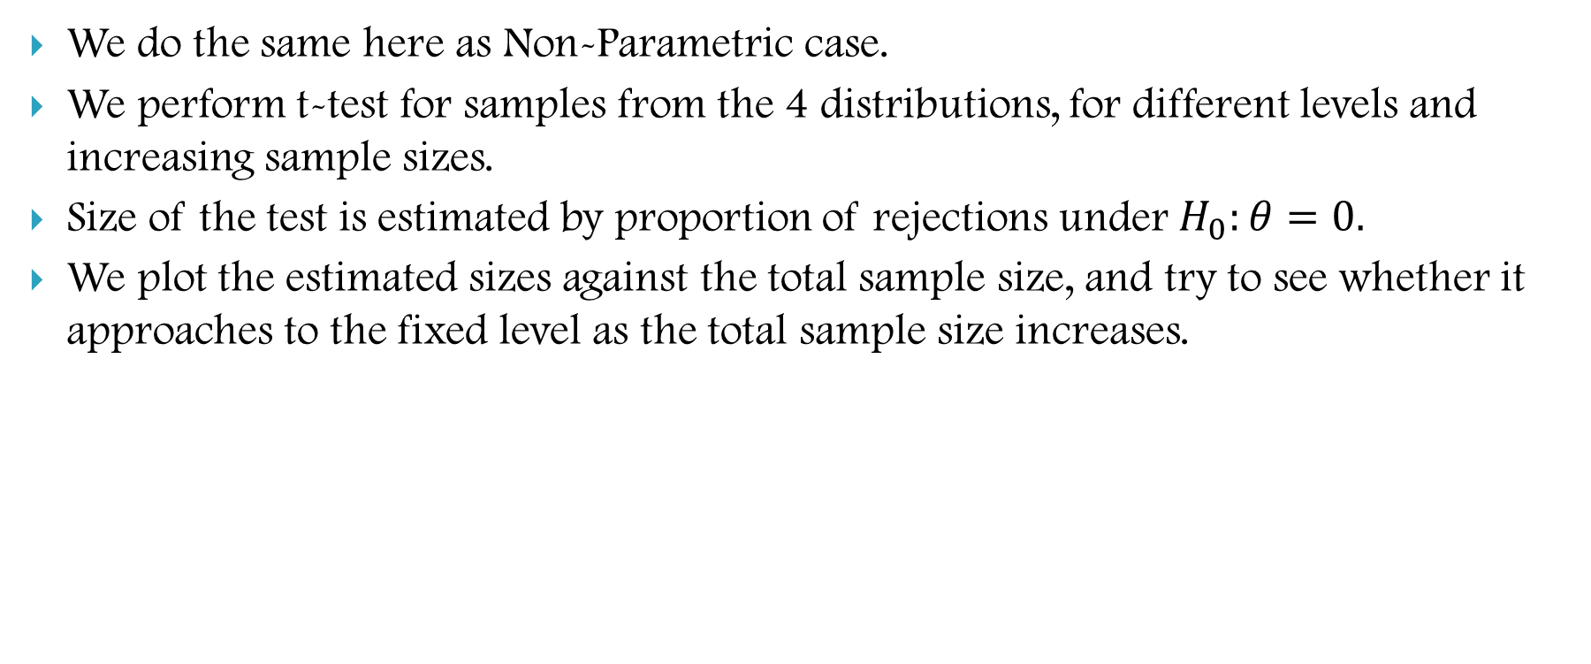
Parametric Counterpart
We do the same here as Non-Parametric case.
We perform t-test for samples from the 4 distributions, for different levels and increasing sample sizes.
Size of the test is estimated by proportion of rejections under $H_{0}:θ=0.$
We plot the estimated sizes against the total sample size, and try to see whether it approaches to the fixed level as the total sample size increases.

Slide 7
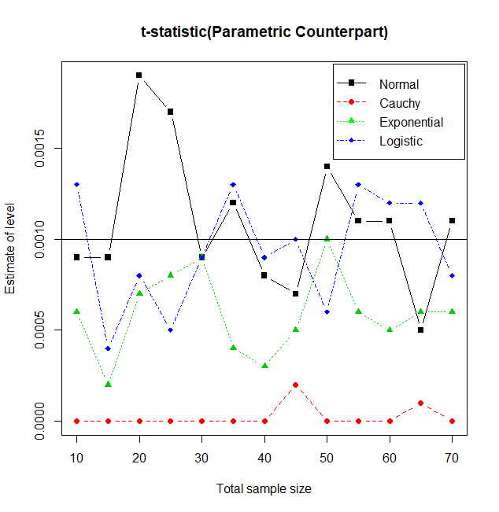
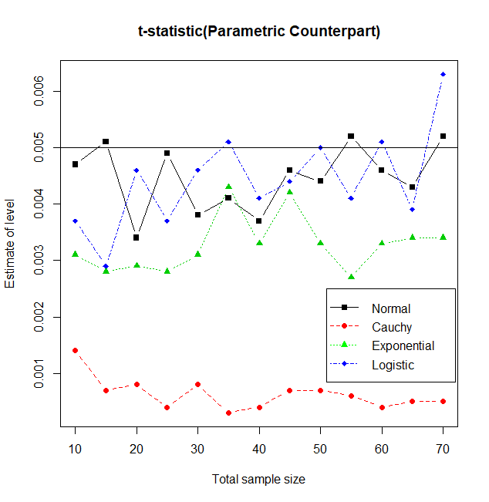


$$α=0.001$$
$$α=0.005$$
In both cases, for samples from normal and logistic distribution, the estimate of size goes closer to the actual level than for sample from exponential distribution as total ample size increases and for samples from Cauchy distribution, the estimate does not at all go closer to the actual level.

Slide 8
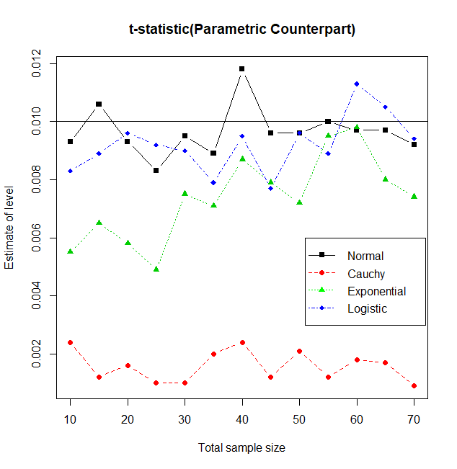
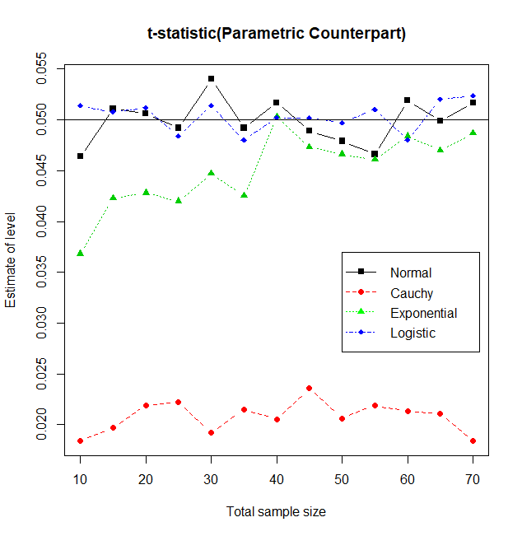


$$α=0.01$$
$$α=0.05$$
Here also, we can see that in case of samples from Cauchy distribution, the estimate of size stays far away from the actual level even if we increase the total sample size and in rest of the cases, the estimate goes close to the actual level.

Slide 9
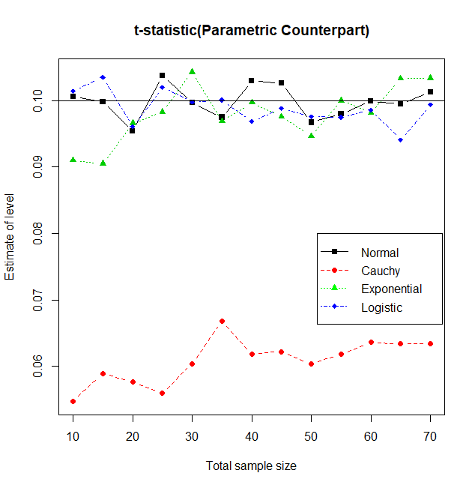
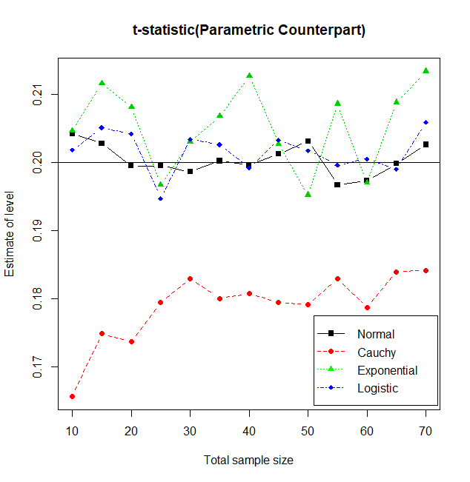


$$α=0.1$$
$$α=0.2$$
For samples from all $4$ distributions except for Cauchy, the estimate of size goes close to the actual level of the test as the total sample size increases.

Slide 10
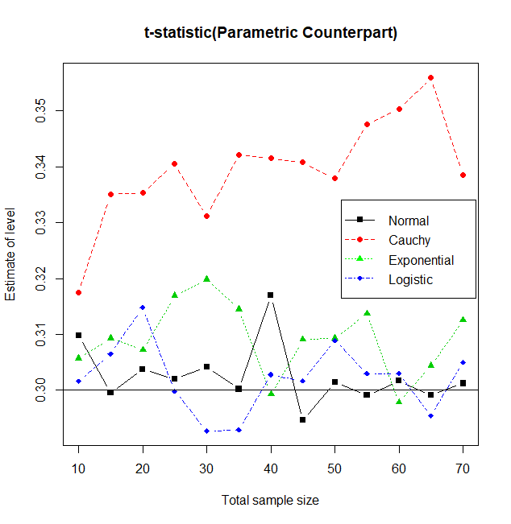

Here also, we can observe that in case of samples arising out of normal, logistic and exponential distribution, the estimate of size gets close to the actual level as the total sample size increases, but for samples from Cauchy distribution, the estimate of size is always much more higher than actual level of the test.
Above observation supports the fact that the statistic is not distribution free.
The statistic performs perfectly when the sample arises out of a normal distribution.
We observe that, for samples from logistic and exponential distribution also, the estimate of size gets closer to actual level as the total sample size increases.
But, for sample from Cauchy distribution, the estimated size does not at all go close to the actual level of the test, so the distribution of the statistic deviates from normality very highly.
$$α=0.3$$

Slide 11
POWER FUNCTION

Slide 12
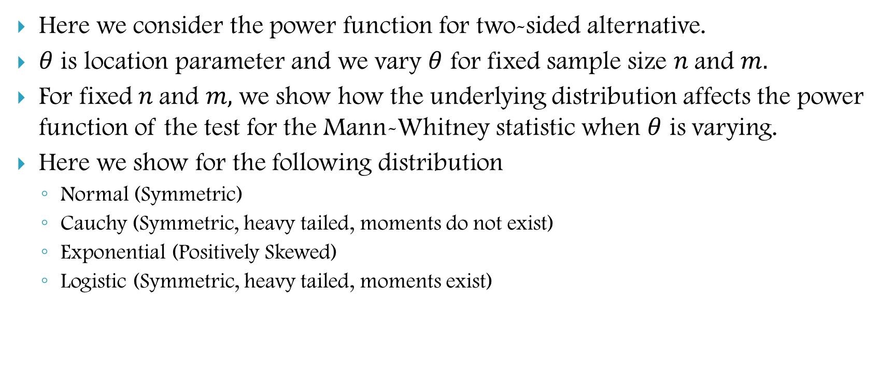

POWER FUNCTION ($β_{n,m}(θ)$)
Here we consider the power function for two-sided alternative.
$θ$ is location parameter and we vary $θ$ for fixed sample size $n$and $m.$
For fixed $n$and $m,$we show how the underlying distribution affects the power function of the test for the Mann-Whitney statistic when $θ$ is varying.
Here we show for the following distribution
Normal (Symmetric)
Cauchy (Symmetric, heavy tailed, moments do not exist)
Exponential (Positively Skewed)
Logistic (Symmetric, heavy tailed, moments exist)

Slide 13
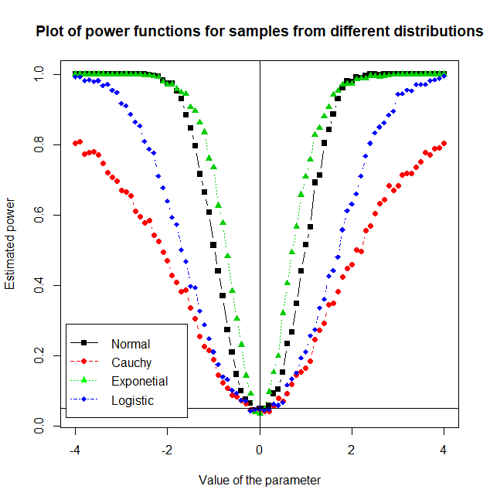
Here we plot the power function of the Mann-Whitney Statistic against different values of the location parameter, where sample size is fixed.
Observations:
Exponential has more power than the other three distributions.
Normal has less power than exponential but for higher values of the parameter power plot moderately coincide with the exponential one.
Cauchy has the least power among the four distribution under consideration.
Logistic has moderately higher power than the Cauchy distribution and less power than the Normal distribution.

Slide 14
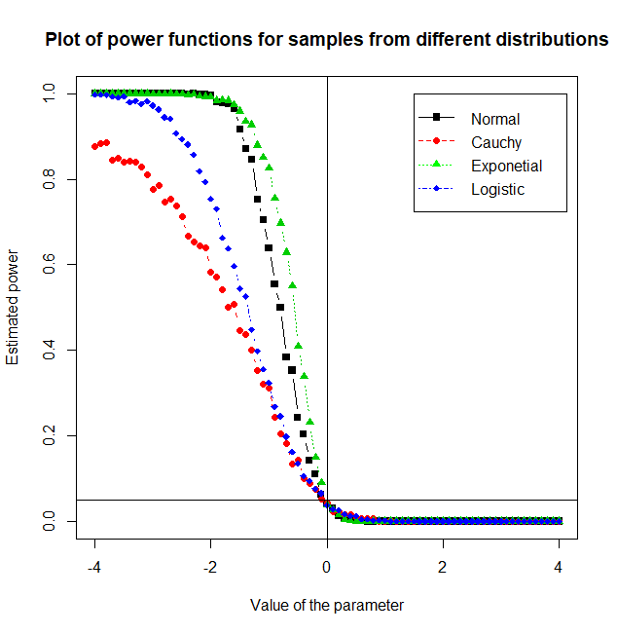
Power function of Mann-Whitney statistic under $H_{1}:F\left(x\right)≥G\left(x\right)$ or equivalently, $H_{1}:θ≤0$
Observation:
Same as previous but power of all the four plot is higher than the previous power plot of both sided alternative.

Slide 15
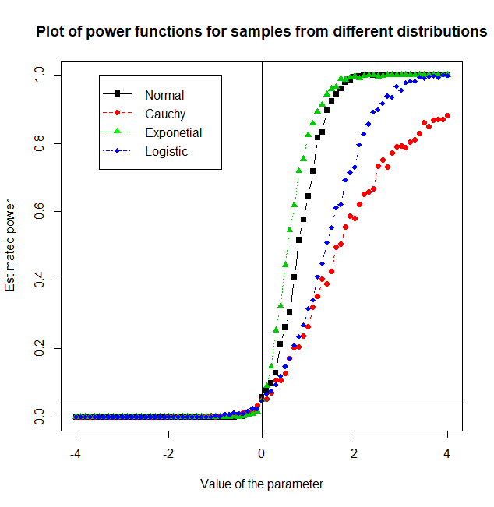

Power function of Mann-Whitney statistic under $H_{1}:F\left(x\right)≤G\left(x\right)$ or equivalently, $H_{1}:θ≥0$
Observation:
Same as previous.

Slide 16
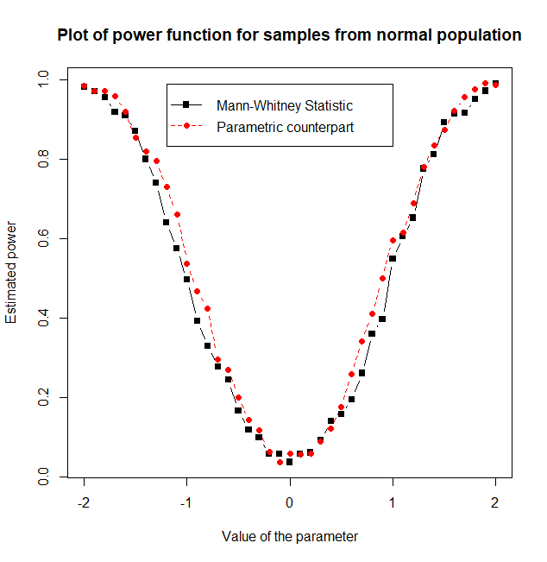
Here we plot the power function of Mann-Whitney Statistic and corresponding Fisher t-statistic
Observation:
Power function of the t-statistic is moderately higher than Mann-Whitney statistic.
Here we have performed t-test, which is the MP test when sample actually comes from normal. So, parametric counter part has higher power as expected.

Slide 17
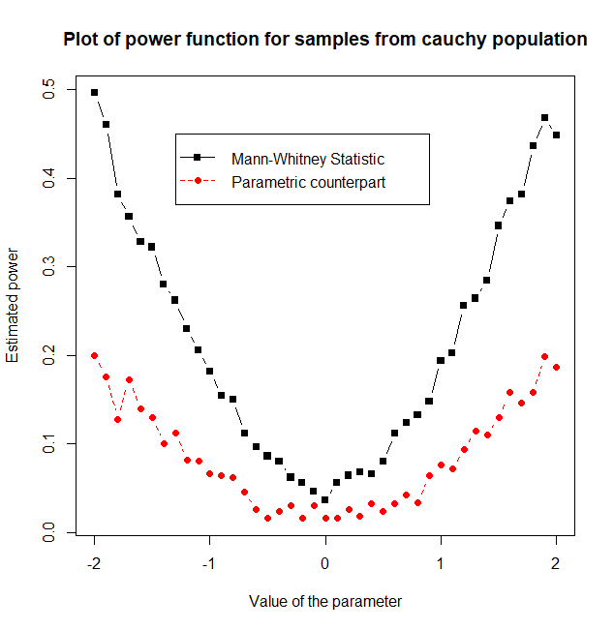
Observation:
Samples come from Cauchy population but we have used the t-statistic which makes normal assumption. So, the power gets decreased.
Since Mann-Whitney statistic does not require any distributional assumption, here power is more than t-test.

Slide 18
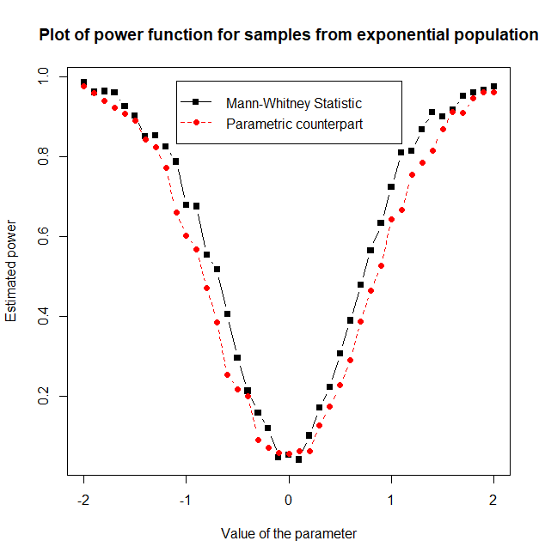
Observation:
We have used the t-statistic assuming the sample to be normal, but samples come from exponential population. So, the power gets decreased but not like Cauchy distribution.
Since Mann-Whitney statistic does not require any distributional assumption, here power is moderately higher than t-test.

Slide 19
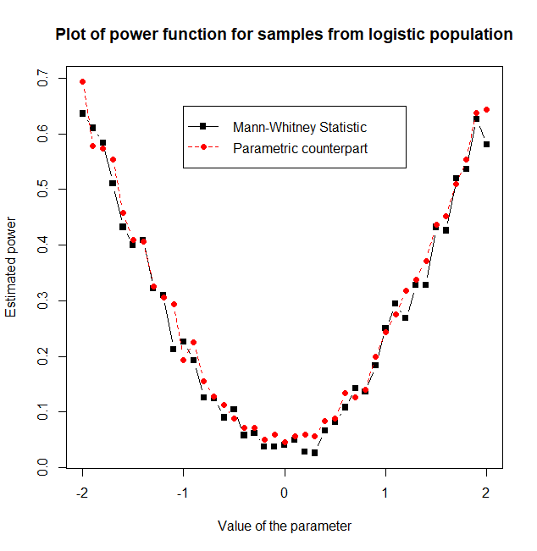
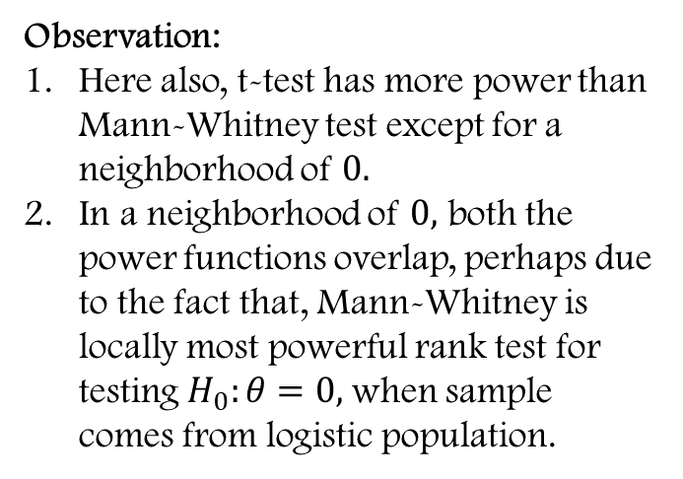
Observation:
Here also, t-test has more power than Mann-Whitney test except for a neighborhood of $0.$
In a neighborhood of $0,$ both the power functions overlap, perhaps due to the fact that, Mann-Whitney is locally most powerful rank test for testing $H_{0}:θ=0,$when sample comes from logistic population.

Slide 20
ASYMPTOTIC BEHAVIOUR OF POWER FUNCTION

Slide 21
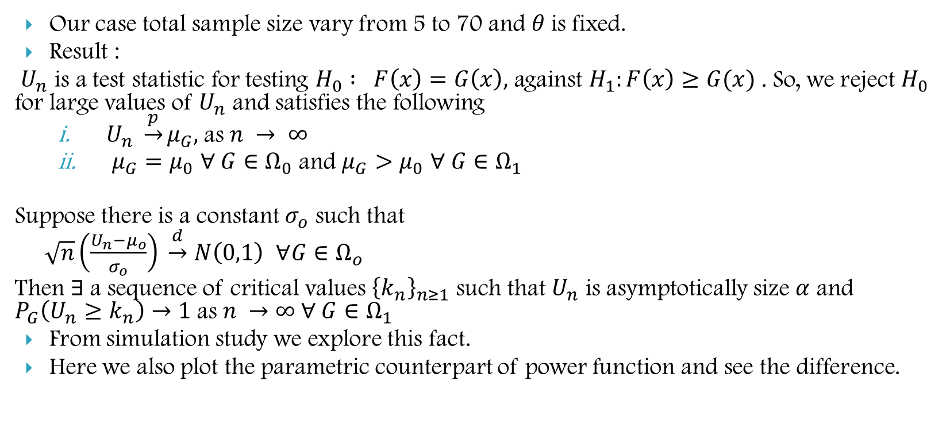

POWER FUNCTION ($β_{n,m}(θ)$)
Our case total sample size vary from 5 to 70 and $θ$is fixed.
Result :
$U_{n}$ is a test statistic for testing $H_{0} : F\left(x\right)=G\left(x\right),$ against $H_{1}:F\left(x\right)≥G(x)$ . So, we reject $H_{0}$ for large values of $U_{n}$ and satisfies the following
$U_{n} \underset{→}{p}μ_{G},$as $n → ∞$
$μ_{G}=μ_{0}$ $∀ G∈Ω_{0}$ and $μ_{G}>μ_{0}$ $∀ G∈Ω_{1}$
Suppose there is a constant $σ_{o}$ such that
$\sqrt{n}\left(\frac{U_{n}−μ_{o}}{σ_{o}}\right) \underset{→}{d}$ $N\left(0,1\right)$ $∀G∈Ω_{o}$
Then $∃$a sequence of critical values ${\left\{k_{n}\right\}}_{n≥1}$ such that $U_{n}$ is asymptotically size $α$ and $P_{G}\left(U_{n}≥k_{n}\right)→1$as $n →∞ ∀ G∈Ω_{1}$
From simulation study we explore this fact.
Here we also plot the parametric counterpart of power function and see the difference.

Slide 22
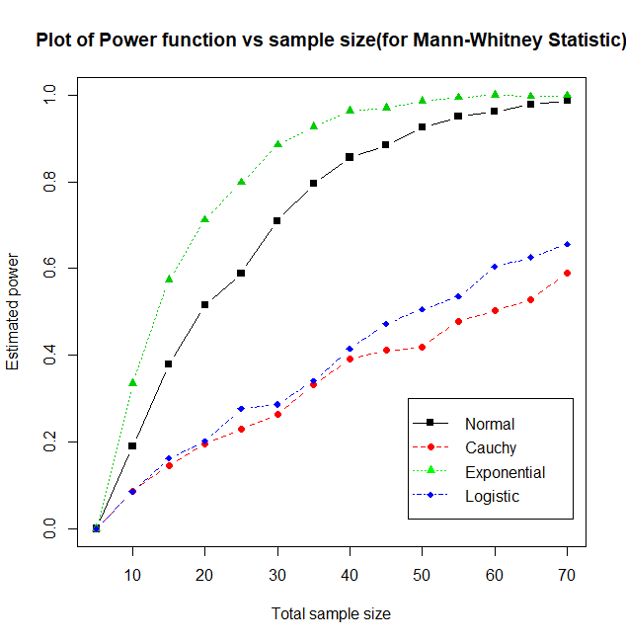
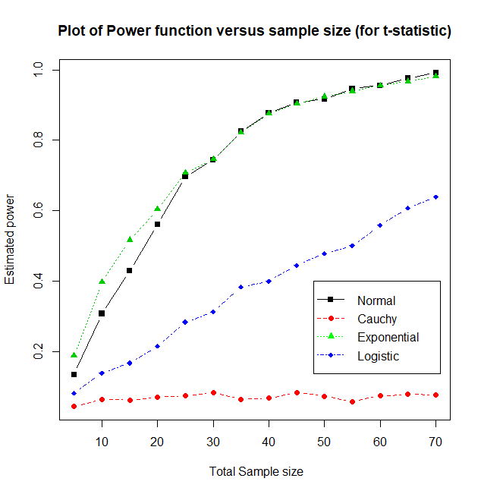


$$θ=1$$
$$θ=1$$

Slide 23
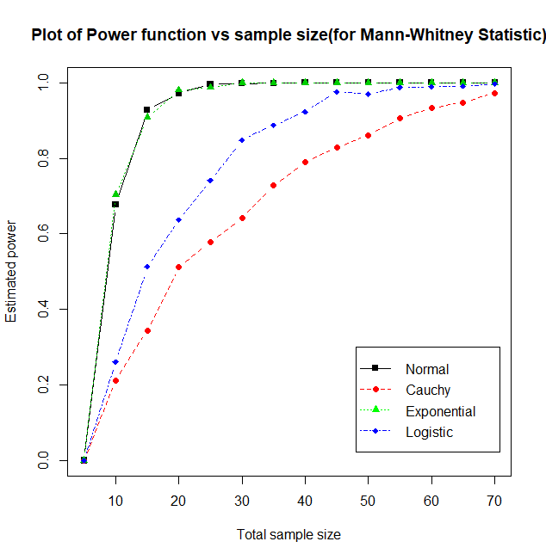
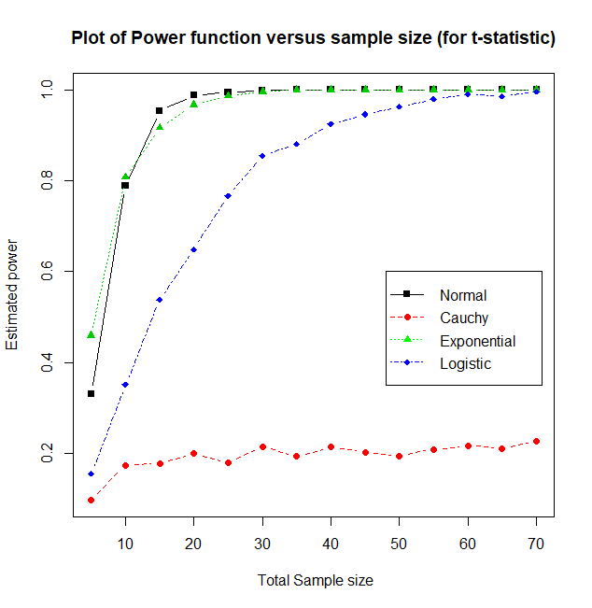


$$θ=2$$
$$θ=2$$

Slide 24
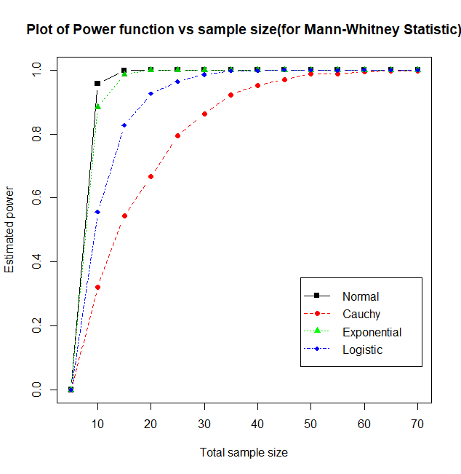
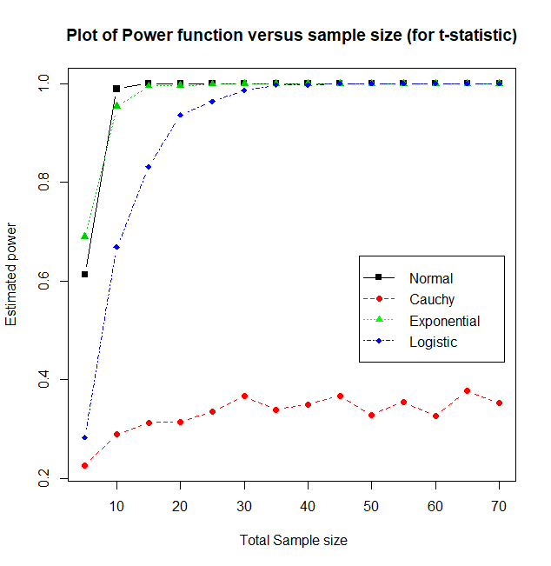

$$θ=3$$

Slide 25
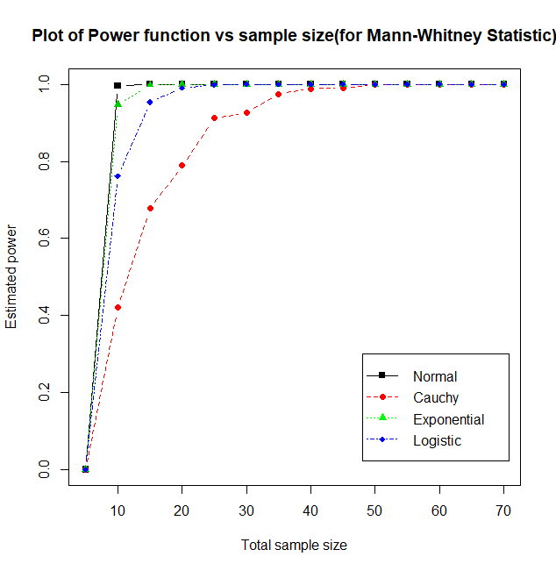
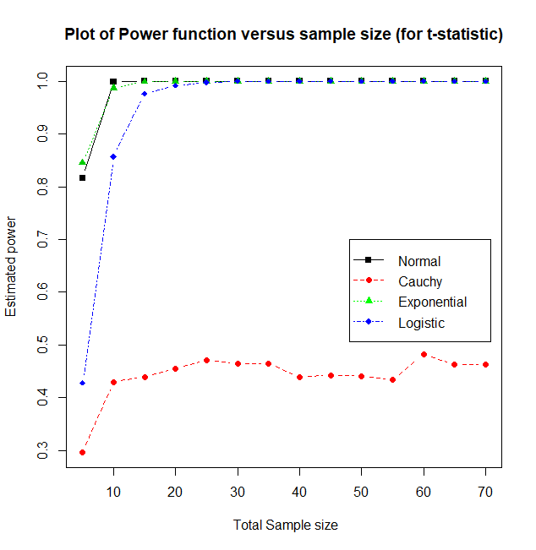


$$θ=4$$
$$θ=4$$

Slide 26
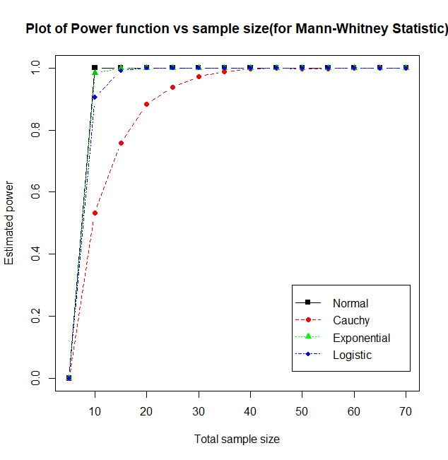
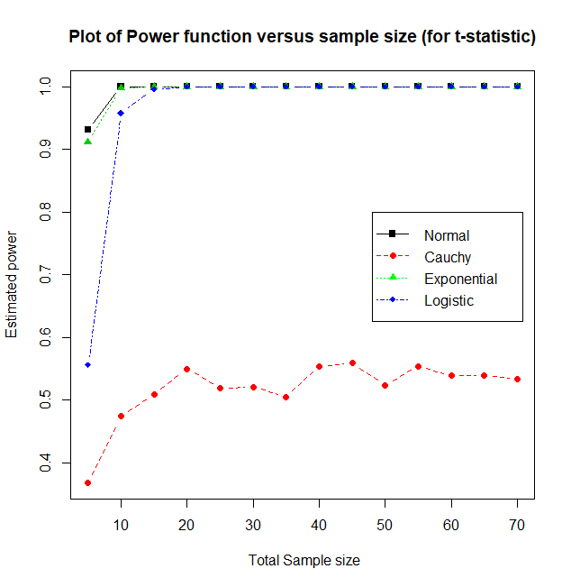


$$θ=5$$
$$θ=5$$

Slide 27
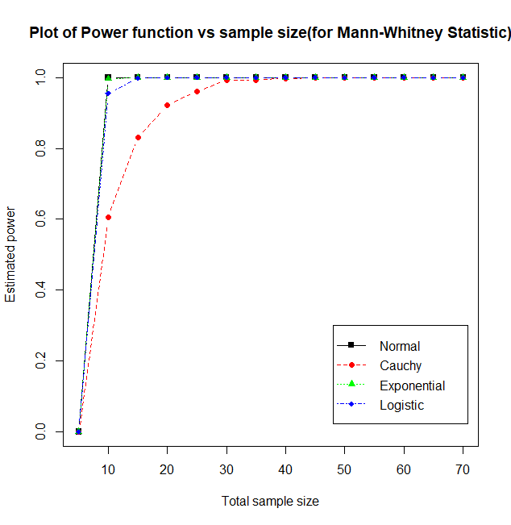
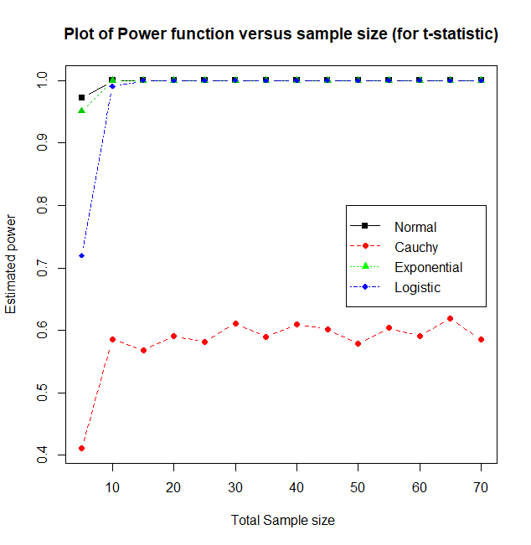


$$θ=6$$
$$θ=6$$

Slide 28
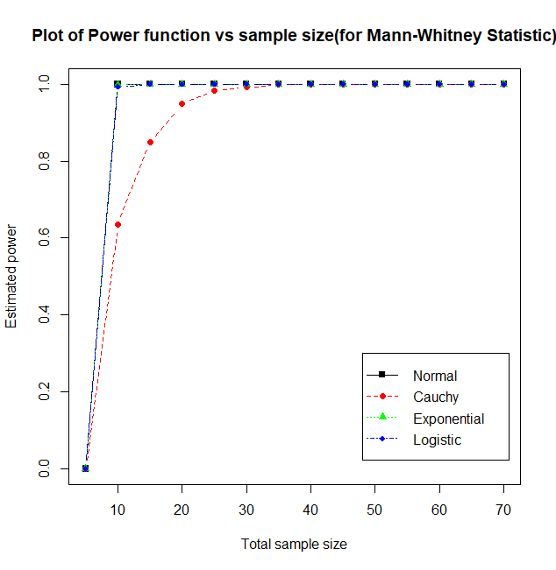
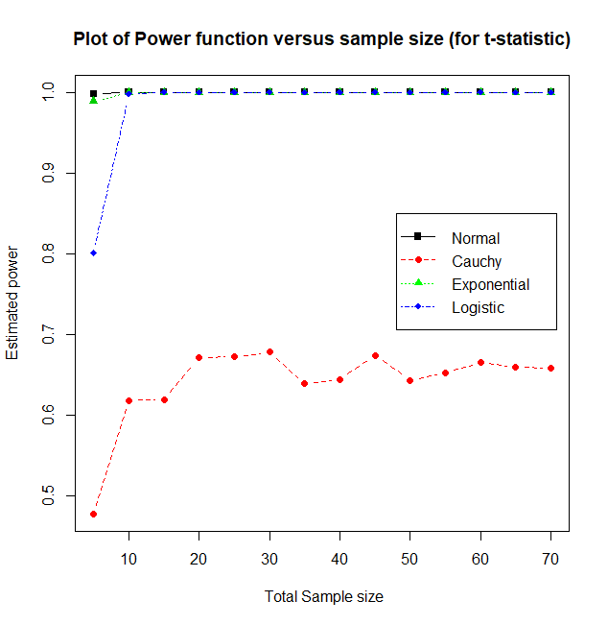


$$θ=7$$
$$θ=7$$

Slide 29
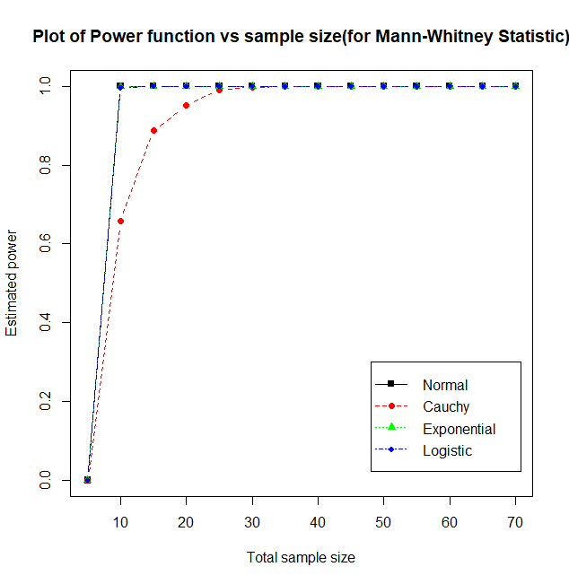
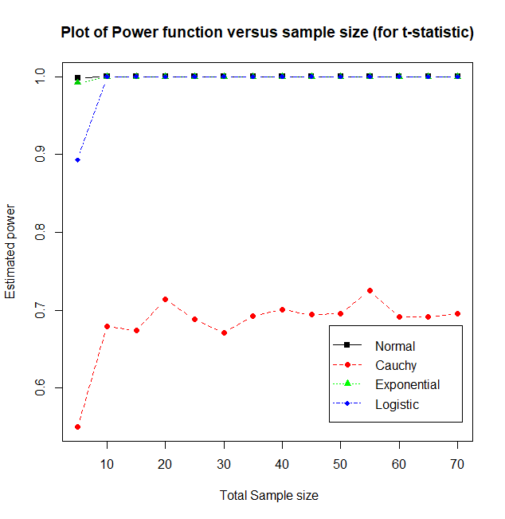


$$θ=8$$
$$θ=8$$

Slide 30
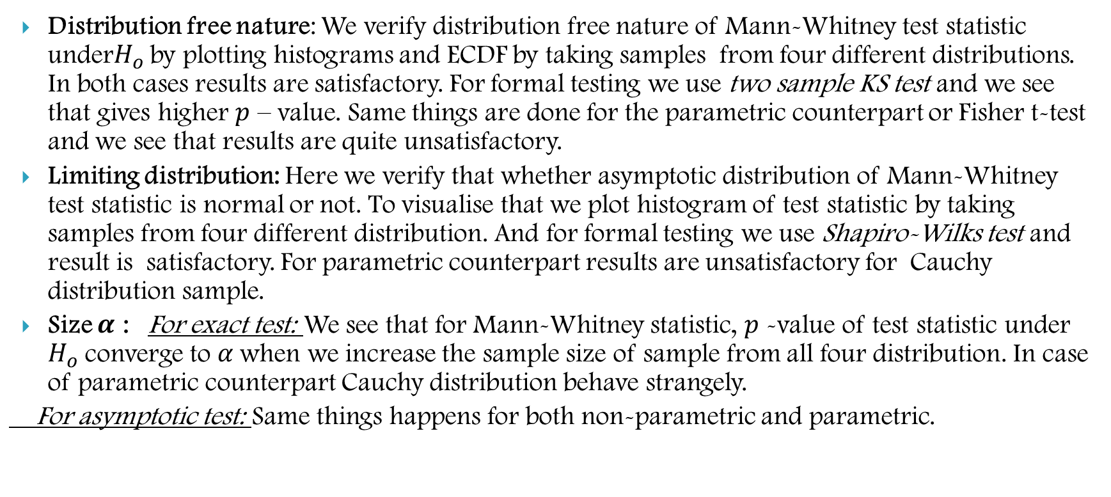
CONCLUSION
Distribution free nature: We verify distribution free nature of Mann-Whitney test statistic under$H_{o}$ by plotting histograms and ECDF by taking samples from four different distributions. In both cases results are satisfactory. For formal testing we use two sample KS test and we see that gives higher $p$ – value. Same things are done for the parametric counterpart or Fisher t-test and we see that results are quite unsatisfactory.
Limiting distribution: Here we verify that whether asymptotic distribution of Mann-Whitney test statistic is normal or not. To visualise that we plot histogram of test statistic by taking samples from four different distribution. And for formal testing we use Shapiro-Wilks test and result is satisfactory. For parametric counterpart results are unsatisfactory for Cauchy distribution sample.
Size $α$ : For exact test: We see that for Mann-Whitney statistic, $p$ -value of test statistic under $H_{o}$ converge to $α$when we increase the sample size of sample from all four distribution. In case of parametric counterpart Cauchy distribution behave strangely.
For asymptotic test: Same things happens for both non-parametric and parametric.

Slide 31
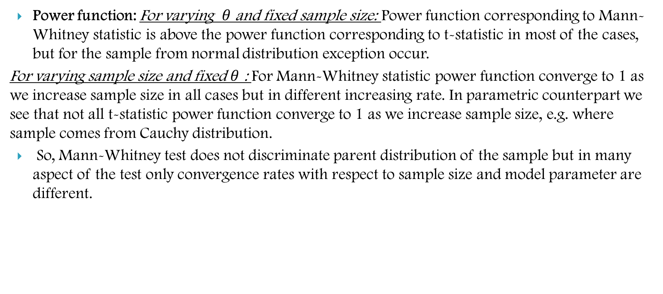
CONCLUSION
Power function: For varying $θ$ and fixed sample size: Power function corresponding to Mann-Whitney statistic is above the power function corresponding to t-statistic in most of the cases, but for the sample from normal distribution exception occur.
For varying sample size and fixed $θ$ : For Mann-Whitney statistic power function converge to 1 as we increase sample size in all cases but in different increasing rate. In parametric counterpart we see that not all t-statistic power function converge to 1 as we increase sample size, e.g. where sample comes from Cauchy distribution.
So, Mann-Whitney test does not discriminate parent distribution of the sample but in many aspect of the test only convergence rates with respect to sample size and model parameter are different.
THANK YOU

